Slide 1
Organizational Behavior 15th Ed
Chapter 5
Robbins and Judge
Personality and Values
Notes:
Chapter 4 introduces us the the concepts of emotions and moods and their effects on Organizational Behavior. These are concepts that have only recently received increased attention in research and practice. Here we will see the results of study and new applications to help make the work place more successful

Slide 2
Chapter 5 Learning Objectives
After studying this chapter you should be able to:
Define personality, describe how it is measured, and explain the factors that determine an individual’s personality.
Describe the Myers-Briggs Type Indicator personality framework and assess its strengths and weaknesses.
Identify the key traits in the Big Five personality model.
Demonstrate how the Big Five traits predict behavior at work.
Identify other personality traits relevant to OB.
Define values, demonstrate the importance of values, and contrast terminal and instrumental values.
Compare generational differences in values and identify the dominant values in today’s workforce.
Identify Hofstede’s five value dimensions of national culture

Slide 3
Define personality, describe how it is measured, and explain the factors that determine an individual’s personality
LO 1
Personality is a dynamic concept describing the growth and development of a person’s whole psychological system;
It looks at some aggregate whole that is greater than the sum of the parts.
Defining Personality
Personality as the sum total of ways in which an individual reacts to and interacts with others.

Slide 4
Define personality, describe how it is measured, and explain the factors that determine an individual’s personality
LO 1
Managers can use personality tests because they are useful in hiring decisions and help managers forecast who is best for a job.
The most common means of measuring personality is through self-report surveys.
Observer-ratings surveys provide an independent assessment of personality.

Slide 5
Define personality, describe how it is measured, and explain the factors that determine an individual’s personality
LO 1
Heredity refers to those factors that were determined at conception.
The heredity approach argues that the ultimate explanation of an individual’s personality is the molecular structure of the genes, located in the chromosomes.
Popular characteristics include shy, aggressive, submissive, lazy, ambitious, loyal, and timid. These are personality traits.
Early efforts to identify the primary traits that govern behavior often resulted in long lists that were difficult to generalize from and provided little practical guidance to organizational decision makers.

Slide 6
Describe the Myers-Briggs Type Indicator personality framework and assess its strengths and weaknesses
LO 2
One of the most widely used personality frameworks is the Myers-Briggs Type Indicator (MBTI).
Individuals are classified as:
Extroverted or introverted (E or I).
Sensing or intuitive (S or N).
Thinking or feeling (T or F).
Perceiving or judging (P or J).

Slide 7
Describe the Myers-Briggs Type Indicator personality framework and assess its strengths and weaknesses
LO 2
INTJs are visionaries.
ESTJs are organizers.
ENTPs are conceptualizers.

Slide 8
Identify the key traits in the Big Five personality model
LO 3
Extraversion,
Agreeableness,
Conscientiousness,
Emotional stability,
Openness to experience.

Slide 9
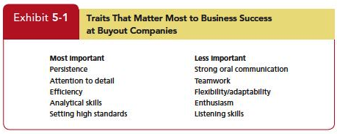
Demonstrate how the Big Five traits predict behavior at work
LO 4

Slide 10
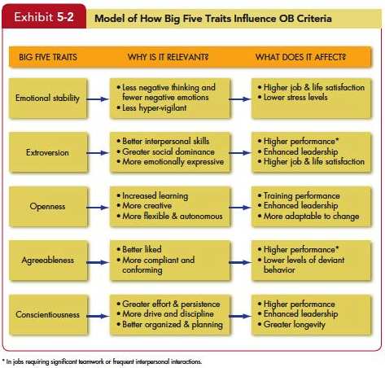
Demonstrate how the Big Five traits predict behavior at work
LO 4

Slide 11
Demonstrate how the Big Five traits predict behavior at work
LO 4
The five factors appear in almost all cross-cultural studies.
Differences are complex but seem to depend on whether countries are predominantly individualistic or collectivistic.
They appear to predict a bit better in individualistic than in collectivist cultures.

Slide 12
Identify other personality traits relevant to OB
LO 5
Core Self-Evaluation (Self-perspective)
Machiavellianism (Machs)
Narcissism
Self-Monitoring
Risk Taking
Proactive Personality
Other-orientation

Slide 13
Define values, demonstrate the importance of values, and contrast terminal and instrumental values
LO 6
Importance of Values
Values lay the foundation for the understanding of attitudes and motivation.
Values generally influence attitudes and behaviors.
We can predict people’s reactions based on understanding values.

Slide 14
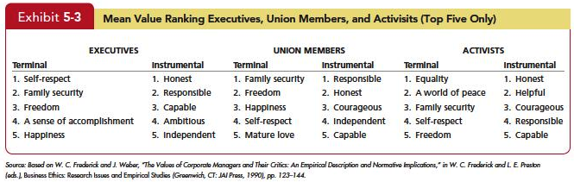
Define values, demonstrate the importance of values, and contrast terminal and instrumental values
LO 6

Slide 15
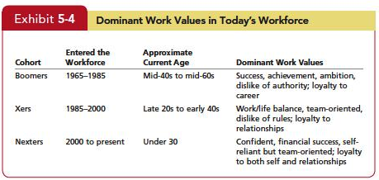
Compare generational differences in values and identify the dominant values in today’s workforce
LO 7

Slide 16
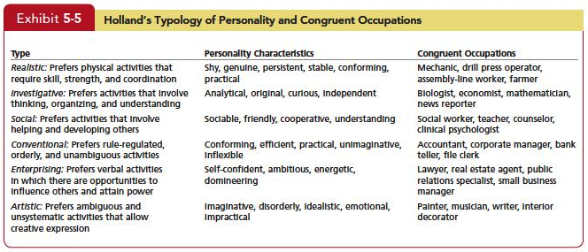
Linking an Individual’s Personality and Values to the Workplace
LO 7

Slide 17
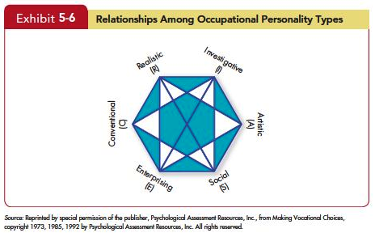
Linking an Individual’s Personality and Values to the Workplace
LO 7

Slide 18
Linking an Individual’s Personality and Values to the Workplace
LO 7
People high on extraversion fit well with aggressive and team-oriented cultures,
People high on agreeableness match up better with a supportive organizational climate than one focused on aggressiveness,
People high on openness to experience fit better in organizations that emphasize innovation rather than standardization.

Slide 19
Identify Hofstede’s five value dimensions of national culture
LO 8
Five value dimensions of national culture:
Power distance
Individualism versus collectivism
Masculinity versus femininity
Uncertainty avoidance
Long-term versus short-term orientation

Slide 20
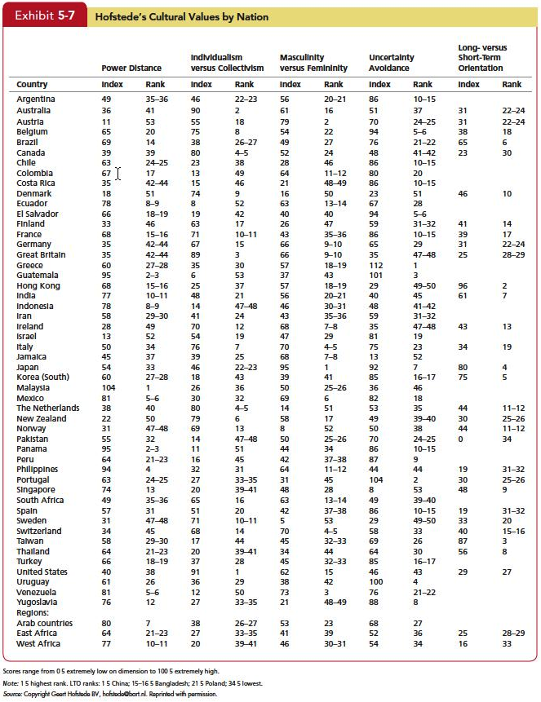
Identify Hofstede’s five value dimensions of national culture
LO 8

Slide 21
Identify Hofstede’s five value dimensions of national culture
LO 8
The Global Leadership and Organizational Behavior Effectiveness (GLOBE) began updating Hofstede’s research with data from 825 organizations and 62 countries.
Variables similar to Hofstede
Assertiveness
Future orientation (similar to Long-term vs Short-term orientation)
Gender differentiation (similar to Masculinity vs Femininity)
Notes:
.

Slide 22
Identify Hofstede’s five value dimensions of national culture
LO 8
Uncertainly avoidance
Power distance
Individualism/collectivism
In-group collectivism
Performance orientation
Humane orientation

Slide 23
Summary and Implications for Managers
LO 8
Big Five provides a meaningful way for managers to examine personality
Managers’ keys
Screening job candidates for high conscientiousness
Factors such as job demands, the degree of required interaction with others, and the organization’s culture are examples of situational variables that moderate the personality–job performance relationship.

Slide 24
Summary and Implications for Managers
LO 8
You need to evaluate the job, the work group, and the organization to determine the optimal personality fit.
Other traits, such as core self-evaluation or narcissism, may be relevant in certain situations, too.
Although the MBTI has been widely criticized, it may have a place in organizations.

Slide 25
Summary and Implications for Managers
LO 8
Knowledge of an individual’s value system can provide insight into what makes the person “tick.”
Employees’ performance and satisfaction are likely to be higher if their values fit well with the organization.
The person who places great importance on imagination, independence, and freedom is likely to be poorly matched with an organization that seeks conformity from its employees.

Slide 26
Summary and Implications for Managers
LO 8
Managers are more likely to appreciate, evaluate positively, and allocate rewards to employees who fit in, and employees are more likely to be satisfied if they perceive they do fit in.
This argues for management to seek job candidates who have not only the ability, experience, and motivation to perform but also a value system compatible with the organization’s.

Slide 27
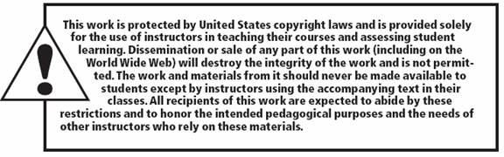
All rights reserved. No part of this publication may be reproduced, stored in a retrieval system, or transmitted, in any form or by any means, electronic, mechanical, photocopying, recording, or otherwise, without the prior written permission of the publisher. Printed in the United States of America.
Copyright © 2013 Pearson Education, Inc. publishing as Prentice Hall

